Slide 1
Mental Health Awareness
Created by: Rebecca Eugene Carly Henriquez Sean Blair
Danielle Romanow
Course:
CMDA320_08 Transmedia Project
Professor:
Dr. Conley

Slide 3
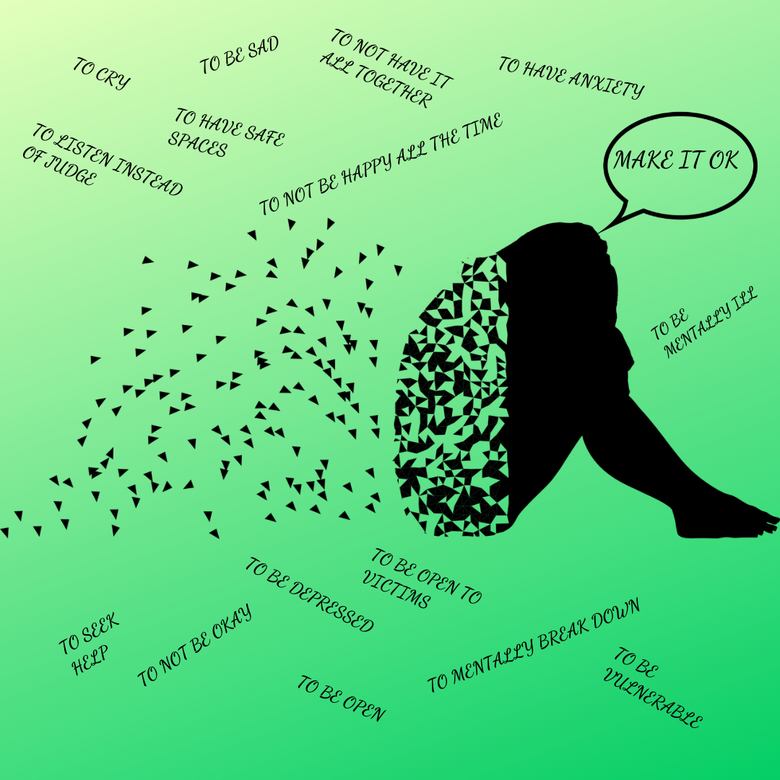
Why Address Mental Health?
We want to normalize the realities of mental health. In a lot of cultures, it’s frowned upon to express your emotions and talk about your feelings. By normalizing the conversation we want to make Mental Illness a social norm.
Show people that you’re not alone because everyone is going through something
LET’S MAKE IT OK BECAUSE IT IS

Slide 4
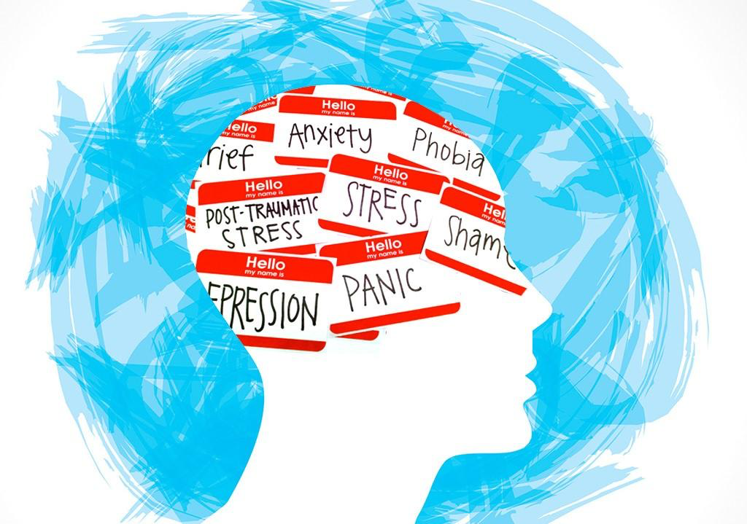
Cultural Aspect
Specific cultures take the concerns of mental health differently especially when it comes to:
Race
Gender
Ethnicity
Emotional damage

Slide 5
Common Types of Mental Disorders
Mood Disorders: depression or bipolar disorder)
Anxiety disorder
Personality disorder
Psychotic disorder (schizophrenia)
Eating disorder
trauma -related disorders (post-traumatic stress disorder)
Substance abuse disorders
ADD/ADHD

Slide 6
Digital Magazine Link
https://henriquezcarly.wixsite.com/mentallyrated

Slide 7
Feature Video
Our videos will focus on mental health from a cultural perspective this will consist of:
2 Narrative videos that describe the effects of Mental Health
Various cultural clubs
Caribbean Student Organization - Caribso
Muslim Student Association - MSA
Latin American Student Organization - LASO
Haitian Student Association - HSA
Black Student Union - BSU
LadiesFirst
An expert from C.A.P.S will explain how they help students of different cultural backgrounds deal with Mental Health

Slide 8
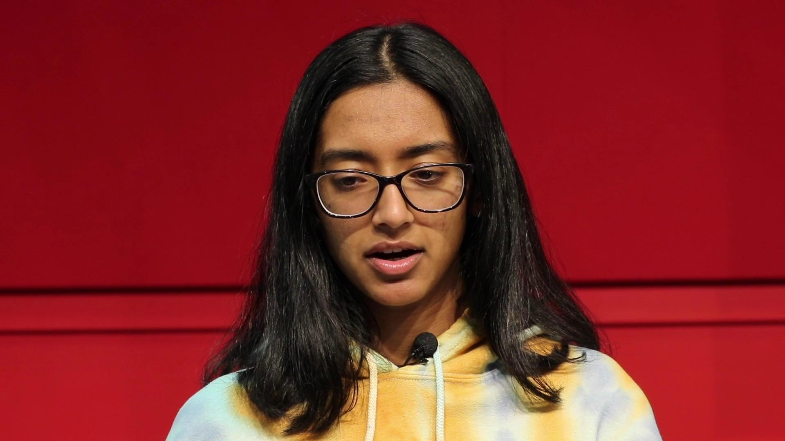
Narrative Video #1
Sunah Choudhry - Mental Health documentary

Slide 9
Narrative Video #3
Student Organizations

Slide 10
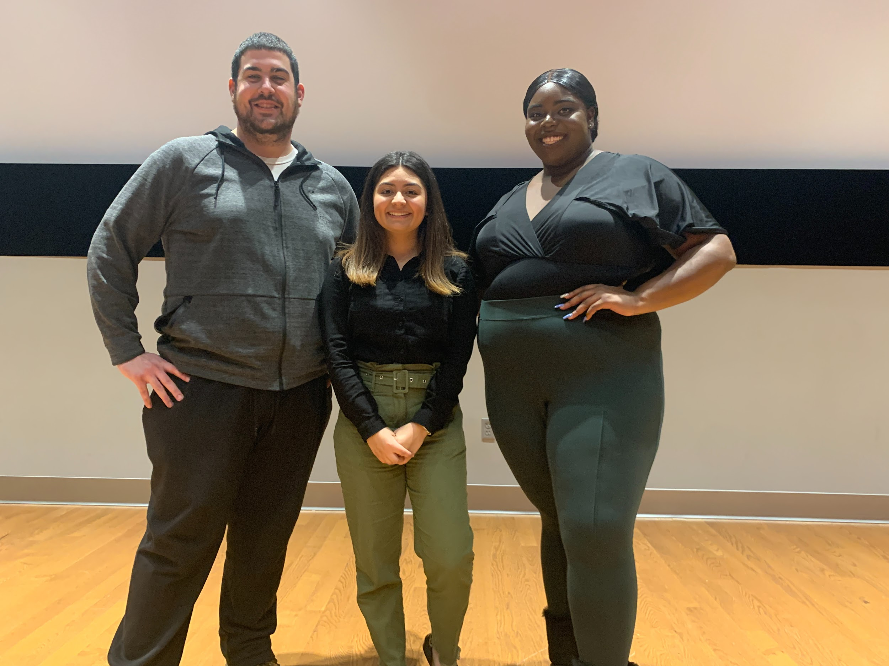
Mental Health Colloquium

Slide 11
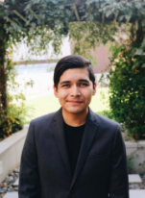
Kenny Gonzales
Ph.D Student, Clinical Psychology

Slide 12
Sudha Wadhwani
C.A.P.S. Video

Slide 13
MSU Resources
A Helping Hand
C.A.P.S
Russ Hall, Side Entrance
Monday through Thursday 9 AM – 5 PM
Friday 8:30 AM – 4:30 PM
Recovery Room
Tuesdays from 3-4:30 p.m. at the Drop-In Center
Let’s Talk
Monday 1-2:30 PM Sprague Library, Room 202
Monday 3:30-5 PM Dickson Hall, Room 344
Tuesday 11 AM – 12:30 PM Morehead Hall, Room 218
Tuesday 3-4:30 PM Student Center, Room 104M (CSI)
Wednesday 10:30 AM – 12 PM Student Center, Room 423
Wednesday 3-4:30 PM Blanton Hall 1002
Thursday 1-2:30 PM CELS Room 328
Thursday 3:30-5 PM Webster Hall, Room 100
Friday 1-2:30 PM Freeman Annex, Room 140
Tao
Guided therapy for stress, anxiety, depression, and other concerns

